Slide 1

Next generation
  INVESTING IN TOMORROW’S WINNER TODAY
  January 2021
Notes:
Thank you to everyone who has made the effort to be on the call today.

Slide 2
Growth strategy
Notes:
Task = IITWT by understanding the opportunity and disruptions created by new developments facing society and the economy.
Empirical studies show growth is key driver of superior corporate performance
!Caveat – growth is challenging to sustain
Key
An investment framework is vital for success.

Slide 3
Capturing megatrends
Waves of change that are slow to form and impossible to reverse
Demographics
Debt
Health
Ageing
Consumption
growth
Welfare systems
Economics
Population
growth
Globalisation
Multipolar
world
Individualisation
Social values
Health
awareness
Digitalisation
Water pollution
Renewable
resources
Connectivity
Nanotechnology
Biotechnology
Environment
Air pollution
Innovation
Source: Julius Baer
Notes:
How do we find growth opportunities?
What is a megatrend?
Why are industry dynamics important?

Slide 4
NEXT GENERATION INVESTMENT THEMES
Mapping the future to five key themes
THEMES | DESCRIPTION
Arising Asia | Growing economies in Asian emerging markets and shifting consumer tastes.
Digital Disruption | The phenomenon of digitalisation, and how it is affecting every corner of our lives.
Energy Transition | The shift from fossil fuels to new sources of energy.
THEMES | DESCRIPTION
Feeding the World | Sustainable production for the additional 2.4 billion people living on the globe by 2050.
Shifting Lifestyles | Ageing population and enhanced longevity are altering global lifestyles.
ARISING ASIA
DIGITAL DISRUPTION
ENERGY TRANSITION
FEEDING THE WORLD
SHIFTING LIFESTYLES
Asian consumer
5G & IoT
Clean energy
Agricultural fertilisers
Digital health
Asian tourism
Automation & robotics
Cleaner China
Agriculture traders
Extended longevity
Healthy China
Cloud computing & AI
Future mobility
Animal health
Genomics
Made in China 2025
Cybersecurity
Shale boom
'Meating' demand
Global education
New Silk Road
Digital commerce
Water stress
Health awareness
Digital content
FinTech
Source: Julius Baer; AI = artificial intelligence, IoT = Internet of Things
Notes:
Focus is paramount
Core competence in 5 themes (static)
Complementary
Caputure the most important megatrends
Sub-themes (dynamic)
Map value chains
Resource intensive (leverage open architecture)

Slide 5

NEXT GENERATION INVESTMENT UNIVERSE
Mapping the future to five key themes
INVESTABLE UNIVERSE
Our expertise enables you to invest in long-term structural growth trends across our five key investment themes and provides access to industries with high entry barriers
Industry rivalry
Sustained growth
STRUCTURAL GROWTH
THE WINNERS OF TOMORROW
We distinguish good growth from bad by selecting companies that generate returns above the cost of capital and have a solid competitive edge with multi-faceted expansion options. You invest in structural growth
Next Generation:
Diversification
INTEGRATED INVESTMENT SOLUTION
Omit losers
ACTIVE RISK MANAGEMENT
PORTFOLIO DIVERSIFICATION
Avoid concentration risk by investing in a portfolio that is well diversified across themes and industries, and sells long-term underperformers
Value & optionality
Competitive advantage
WINNING FIRMS
Notes:
Winning companies in winning industries possess optionality.
Risk assessment from industry to firm level.

Slide 6
THE HYPE CYCLE
Attention-grabbing technologies attract public focus, which tends to inflate expectations, encourage hype and momentum trading
Expectations
NEXT GENERATION
Machine learning
Smart robots
Autonomous driving
PEAK OF INFLATED EXPECTATIONS
Blockchain
PLATEAU OF
PRODUCTIVITY
SLOPE OF ENLIGHTENMENT
Quantum computing
Commercial UAVs (drones)
Gene testing
General artiﬁcial intelligence
Virtual reality
Plateau reached in:
< 2 years
2 to 5 years
5 to 10 years
> 10 years
TROUGH OF DISILLUSIONMENT
TECHNOLOGY TRIGGER
R&D > 1st-gen. products > Failures > Consolidation > 5 % adoption > 3rd-gen. products > High-growth phase > 30 % adoption
Time
Source: Gartner, Julius Baer
Notes:
Advanced technology focus
Early stage more challenging
Understand technologies that evolve and capture market share

Slide 7

The pandemic is accelerating trends in technology and healthcare

Slide 8











A boost to Next generation trends in Technology
Working from Home
  Segments with Next Gen exposure
  Cloud Computing Infrastructure & Services
  Cybersecurity
  Cloud Software & Apps
  Compute & Networking Semiconductor
Online shopping world
  Segments with Next Gen exposure
  Online Retail
  Digital Payments
  Food Delivery
  Automation
Stay at home economy
  Segments with Next Gen exposure
  Video Streaming
  Video Gaming & eSports
  Telemedicine
  Social Media
  Online Dating
Source: Julius Baer

Slide 9












Pandemic speeding up change in healthcare
Digital Health and Genomics are standing to experience accelerated
technology developments and adoption post pandemic
DIGITAL HEALTH
Segments with Next Gen exposure
Health IT e.g. advanced analytics
Telemedicine/Telehealth
MedTech e.g. remote monitoring
Payers e.g. value-based care
GENOMICS
Segments with Next Gen exposure
Life Science tools with better diagnostics (e.g. testing)
Gene sequencing
Contract Research Organisations speeding-up clinical trials
Contract Manufacturer helping to scale drug & vaccine production
Source: Julius Baer

Slide 10
80% of businesses
not on the cloud

Slide 11
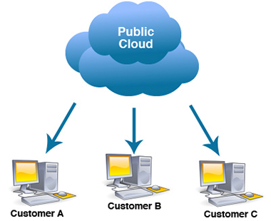
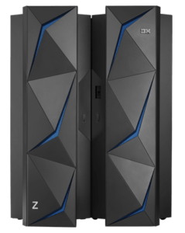
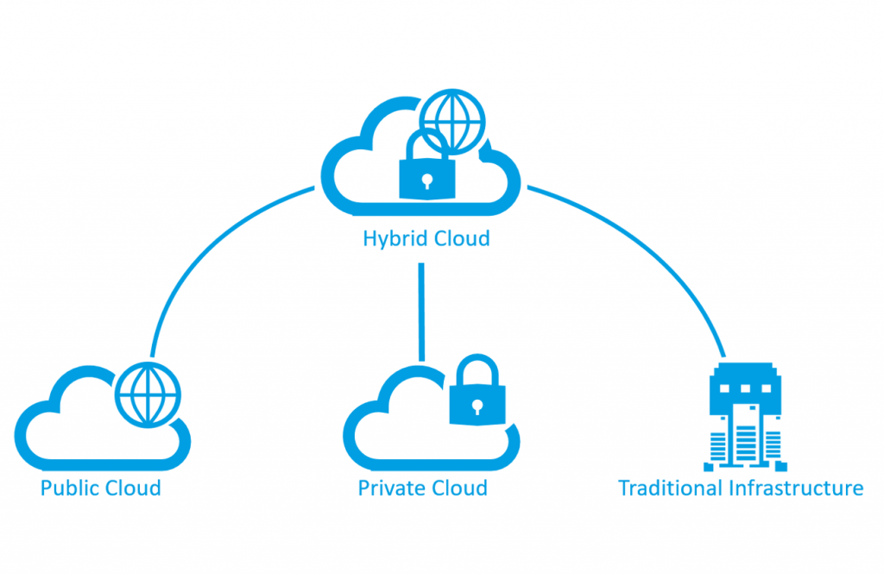
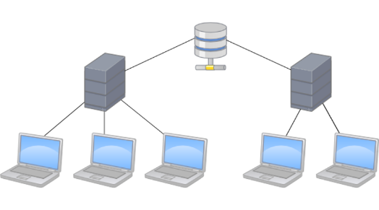
DIGITAL DISRUPTION
Innovation mitigating cloud adoption risks
CENTRALISED COMPUTING
PUBLIC CLOUD ERA
MAINFRAME ERA
HYBRID CLOUD ERA
DECENTRALISED COMPUTING
CLIENT-SERVER ERA
1980
1990
2000
2010
2020E
Source: Julius Baer
Notes:
Cloud adoption for enterprises still in its infancy
20% in cloud
80% decentralised
5G to accelerate shift
Adoption risks such as privacy and security mitigated with hybrid solutions

Slide 12
Cloud taking share of IT spending
Businesses are continuously shifting it spending to the cloud
CLOUD COMPUTING GROWING AS A SHARE OF IT SPENDING
HYPERSCALER TO ACCOUNT FOR HALF OF ALL DATA CENTRE SPENDING BY 2025
Source: Citigroup, Julius Baer; E=estimate
Source: Synergy Research, IDC, Citigroup, Julius Baer; E=estimate

Slide 13

Cloud transformation
Important advances adding value and accelerating product innovation
Components
IaaS
Paas + SaaS
Services
Processors
Memory
Routers
Network Servers
Administration
Virtualisation
Platforms
Data management
Automation
CRM
Consulting
Fintech
Health IT
>
>
>
Consumer
BIG DATA, MACHINE LEARNING/AI, SECURITY
Intel
Samsung
Qualcomm
Nvidia
Cisco
TSMC
Amazon AWS
Microsoft Azure
Google
Oracle
Microsoft
Google
Salesforce
ServiceNow
Adobe
Amazon
Accenture
Veeva
Facebook
Source: Julius Baer
Notes:
Importance of industry dynamics (solar example)
Company’s that leverage these platforms to create innovative customer solutions are the next wave of growth
The value-add that these services create for customers is the reason business have to shift to the cloud
Services to become the flywheel with IaaS remaining the consolidated engine room
Preference for hardware security solution vs software
Hardware b2b
Higher levels of IP
Faster network traffic
EDA (Electronic Design Automation – Semi Design Software)
Leveraging specialisation and increasing complexity
AI runs best on custom chips
Small chips = increasing risk and complexity
Driving demand for simulations and testing

Slide 14
People > 60 years old
Will rise from
900 million to 2 billion
Between 2015-2050
Notes:
Between 2000 and 2050, the proportion of the world's population over 60 years will double from about 11% to 22%. The absolute number of people aged 60 years and over is expected to increase from 605 million to 2 billion over the same period.
It took more than 100 years for the share of France's population aged 65 or older to double from 7 to 14%. In contrast, it will take countries like Brazil and China less than 25 years to reach the same growth.
The number of people aged 80 years or older will have almost quadrupled between 2000 and 2050 to 395 million.

Slide 15
Shifting lifestyles
Demographics burden health systems
More expensive healthcare for diminishing benefit
AGING DEMOGRAPHICS ARE RESPONSIBLE
Source: Organisation for Economic Cooperation and Development (OECD), UNPD, Julius Baer; PPP = purchasing power parity, USA = United States of America, CHE = Switzerland, DEU = Germany, JPN = Japan, CHN = China, WLD = World
Source: United Nations, Julius Baer; Note: Median projection has been used.
Next Generation investment solutions
Notes:
2/6mins
Chart 1
Appears wealthy countries spend more on healthcare but this does not meaningfully increase life expectancy?
The law of diminishing returns appears to evident, suggesting more countries spend on healthcare is not reflected in longer life expectancy
Chart 2
Columns indicate current and projected 2050 world population for for different age groups.
In 2050, the above 64 years age group is still lowest of the three groups.
However the dots in that graph indicate the annual growth rates, and here we see the aged group is growing at 3 times the overall population rate.
Wealthy countries currently have larger aged populations
Conclusion
If we look at the US, 71 % of all healthcare spending is towards treating people with multiple chronic conditions (obesity a key driver of chronic illness).
25% of Americans have multiple chronic conditions but in the elderly it’s 75%
The aging population is driving up healthcare spending and overburdening healthcare systems. While the western world is leading in aging demogaphics the rest of the world is catching up fast.
Key
In the US high healthcare spending accounts for 18% GDP (offsets low social spending) and given the acceleration population, spending is expected to reach 27% of GDP by 2025. The status quo is unsustainable.

Slide 16


























towards digital health and beyond
Who is incentivised to drive alignment and efficiencies?
Core Technologies
Mobile
Cloud
Big Data Analytics
Internet of Things
Prevention
Diagnosis
Treatment
Home
Healthy Lifestyle
Health IT Innovation
Wearables
Imaging
Genomics
Robotics
Additive Manufacturing
Source: Julius Baer, Bellevue Asset Management
Notes:
3/11mins
What does a sustainable value based care healthcare system vision look like in reality?
Technologies increasing awareness that results in healthier lifestyles, early detection of, and subsequent delaying the onset of chronic disease.
Telehealth and virtual doctor visits will move diagnosis and treatments out of hospitals into smaller clinics.
Hospital resources will be focused on more critical conditions with robotics democratising surgery by raising the standard of lower skilled surgeons.
Hospital stays will be shorter due to less invasive treatments and tailor-made implants. Patients will be able to recover at home with monitoring devices and virtual check-up’s.
Key
Costs, capital allocation and ethical debate will be unavoidable. Perhaps the biggest challenge for governments is in structuring their healthcare systems is to incentivise innovation that drive long-term efficiencies. It warrants an holistic and strategic approach that removes existing fragmentation and adoption barriers.
Focus needs to be on efficiencies not costs.

Slide 17








Digital Health
Applying digital technologies with “domain-knowledge” to healthcare
MedTech
Health IT
Services & Providers
Prevention awareness
Remote patient monitoring
Minimally invasive surgery
Surgical robotics
Electronic health records
Health analytics
Data analytics
Genomics
Precision medicine
Population health management
Payers
Clinics / hospitals
Pharmacies
Distributors
Home health
Telemedicine / Telehealth
>
>
Consumer/Patient
Portfolio examples
Source: Julius Baer; Company material; References to specific stocks do not imply any investment recommendation.
Next Generation investment solutions
Notes:
4/17mins
Considerations given to how we structure our Next Generation portfolio.
No exposure to drug development industry
Small biotech are block buster factories with high risks (failure and dilution) that are overall value destroying.
Drug development costs are rising over time as clinical trial duration increases and success rate for new drugs falls.
Drug development – slower growth – high valuations – regulatory headwinds – increasing complexity in new diseases, patent (biosimilar) cliff for existing cash cows
Research – efficiencies in trial selection, etc. accelerating growth segment, fragmented starting to consolidate, consolidators have global footprint latest tech big data – competitive advantage more observable
Diagnositcs – arms (data) dealer in explosion of biotech startups, hospital testing increasing, data demand, consolidating and innovating simultaneously, increasing concentrated.
Services – big healthcare spend bucket (10% drugs, 66% services), inefficient, consolidating and digitalising data, moving away from old paper system (error prone)
Key - Focus needs to be on driving efficiencies not costs
Rapidly aging population and burdensome healthcare costs unsustainable → Greater access to healthcare data will help drive much needed efficiencies and facilitate innovation in how that data is utilised → Our role at Next Generation is to add value by mapping and undestanding the high growth opportunities along exposed value chains → Seek out superior investment opportunities.
Abbott – diversified player with recent acquisitions tilting the group towards MedTech and diagnostics. Well positioned to higher growth segments (e.g. diagnostics, cardiovascular devices and neuro-modulation). Diagnostics business holds ~15% of the global market and is second only to Roche. Medical Devices (Libre + MitraClip) and Diagnostics (Alinity) key growth drivers. Sensor technology.
INO - operates a cloud-based healthcare data analytics platform used by payers, hospitals, physicians, clinical facilities, and pharma/life sciences companies. Products provide predictive analytics that can identify gaps in care, quality, data integrity, and financial performance. The software platform holds data on over 300m US patients, providing insight for over 1m physicians in 0.55m clinical facilities.
UNH - world’s largest MCO is a key beneficiary and driver of the shift towards value-based care and digital health. We believe MCOs are in the leading position to ultimately ‘own the customer’ and guide them through the evolution of digital health services. Connecting the fragmented parts of the industry – similar to how search engines connected the internet.

Slide 18
Genomics | The future of medicine
Falling sequencing costs will drive efficiencies
PLUMMETING SEQUENCING COSTS
GOES BEYOND ‘NORMAL’ PROGRESS
PERSONALISED TREATMENT IS
THE FUTURE OF MEDICINE
Source: Human Genome Project, Julius Baer
Source: Personalised Medicine Coalition, Julius Baer
Next Generation investment solutions
Notes:
Progress in gene sequencing and efficiency gains have been amazing reducing one of the main barriers
First human genome sequence cost USD3bn and took 13 years of computing power. Today it cost USD1k takes a couple of hours.
DNA sequencing will become part of our daily check-ups and identify genetic mutations and potential for chronic disease.
As you age, your chances of getting heart disease, cancer, and diabetes increase as genetic mutations arise within cells.
US healthcare spending to increase from 18% to 27% of GDP over the next decade.
Thanks to gene sequencing we are becoming really good at reading genes (like an autobiography) which will improve personalised drug selection and effectiveness (pharmacogenomices - immediate cost benefits)
The next step will add writing functionality (ability to rewrite your story) with gene editing technologies such as CRISPR and CAR-T to develop even more effective personalised treatments (longer-term cost benefits)
On the cusp of a explosion in gene sequencing which will drive innovation in the space as leveraging the data (preventative, drug efficiency and education) becomes a key differentiator

Slide 19





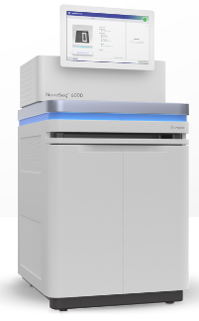
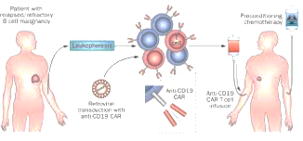
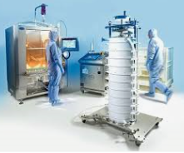
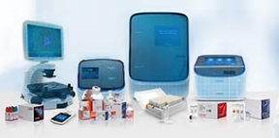
Genomics | the path to personalised treatment
Moving fast from reading to understanding to targeted treatment
Drug Development
Research
Diagnostics
Services
Data
Capital
Intellectual Property
Trial development
Cell & gene therapies
Contract research orgsanisations (CROs)
Analysis & Studies
Clinical trials
Contract manfuacturing
Sampling
Sequencing
Analytics
Lifescience tools
Payers
Clinics / Hospitals
Health IT
Distributors
Education
>
>
>
Consumer / Patient
Portfolio examples
Source: Julius Baer; Company material; References to specific stocks do not imply any investment recommendation.
Notes:
- Small biotech are block buster factories with high risks (failure and dilution) that are overall value destroying.
Drug development costs are rising over time as clinical trial duration increases and success rate for new drugs falls.
Drug development – slower growth – high valuations – regulatory headwinds – increasing complexity in new diseases, patent (biosimilar) cliff for existing cash cows
Research – efficiencies in trial selection, etc. accelerating growth segment, fragmented starting to consolidate, consolidators have global footprint latest tech big data – competitive advantage more observable
Diagnositcs – arms (data) dealer in explosion of biotech startups, hospital testing increasing, data demand, consolidating and innovating simultaneously, increasing concentrated.
Services – big healthcare spend bucket (10% drugs, 66% services), inefficient, consolidating and digitalising data, moving away from old paper system (error prone)
Hospitals too fragmented with low turnover.
Rapidly aging population and burdensome heallthcare costs unsustainable → Greater access to genomic data will help drive much needed efficiencies and facilitate innovation in how that data is utilised → Our role at Next Generation is to add value by mapping and undestanding the high growth opportunities along the value chain → Seek out superior investment opportunities.
Concerns replacing insurance premiums with taxes in the US single nonprofit public payer would slow innovation and efficiency gains – sacrifice long-term productivity for short-term cost gains – sounds simple with reality more complex.
Focus needs to be on efficiencies not costs.

Slide 20
Winners & Losers

Slide 21
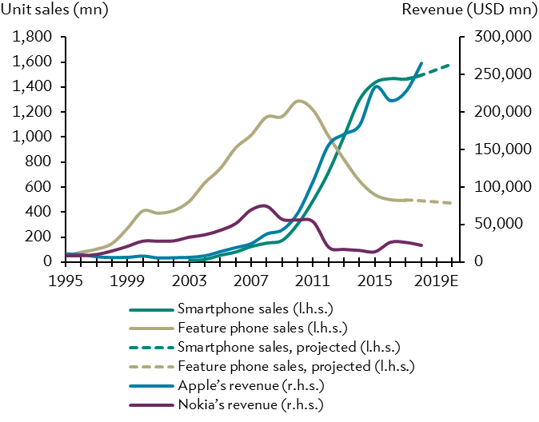
Choosing the winners of tomorrow
Competitively advantaged firms in structurally growing industries
Structural growth is imperative
Revenue or profit growth alone are not enough to outperform over the long-term. Competitive advantage, underpinned by good strategic management and execution, is key.
Growth defines industry dynamics: what feature phones were to Nokia, smartphones will be for Apple: first a source of revenue growth, and then of decline…
GOOD GROWTH
BAD GROWTH
Management generates returns above the cost of capital
Management generates returns below the cost of capital
Capital-intensive investment
Increasing market share
Creating shareholder value
Reliable growth outlook
Source: International Data Corporation (IDC), Gartner, Bloomberg Finance L.P., company reports

Slide 22
a great industry: Semi design software (EDA)
Semiconductor design industry combines structural growth with high barriers to entry
STEADY GROWTH
INVESTMENTS ARE MADE
CASHFLOWS GROWING
MARGIN EXPANDING
ADVANCED CHIP DESIGN COSTS RISING EXPONANTIALLY WITH SOFTWARE-SHARE BENEFITTING MOST
Source: Bloomberg Finance L.P., International Business Strategy Corporation, Julius Baer;
Note: ‘FY20’ refers to trailing 12-month fundamental data, y/y = year-on-year;
EDA= Electronic Design Automation

Slide 23
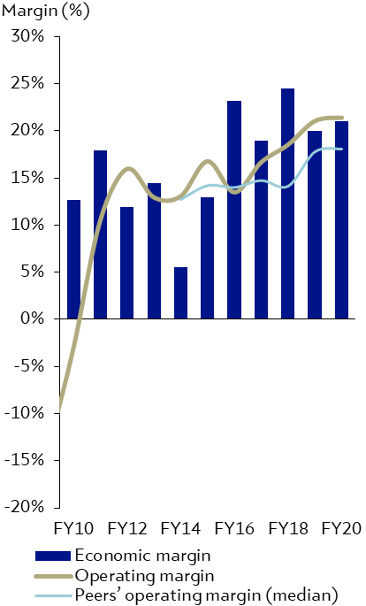
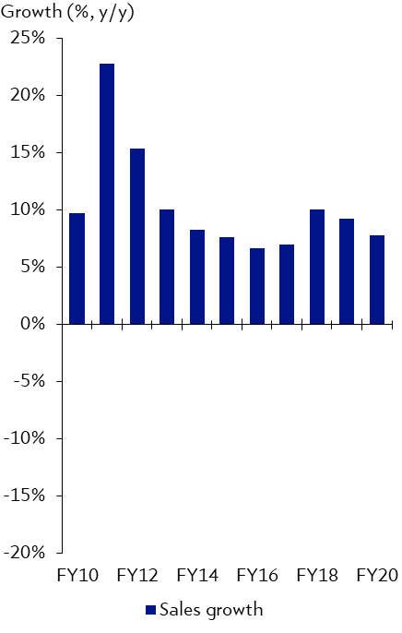
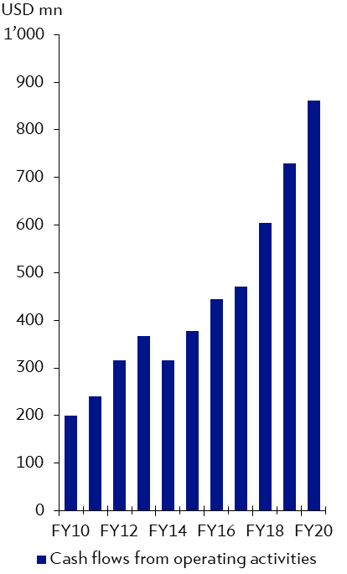
EDA LEADER: Synopsys
A pioneer shaping semiconductor design and leading in innovation at the edge
SYNOPSYS: OPERATING MARGIN VS PEERS
SYNOPSYS : SALES GROWTH
SYNOPSYS : CASH FLOWS
Improving margins profile...
…combined with growth potential…
…and high cash generative business model.
Source: Bloomberg Finance L.P., Julius Baer; Note: ‘FY20’ refers to trailing 12-month fundamental data, y/y = year-on-year
References to specific stocks do not imply any investment recommendation

Slide 24
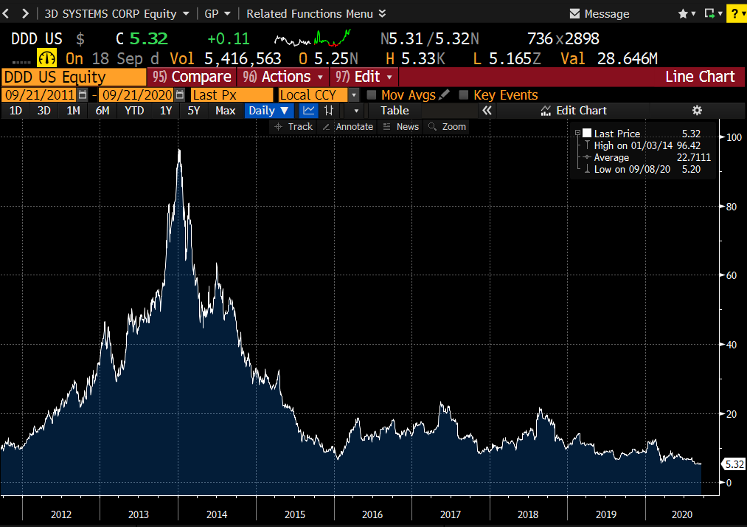
A BAD industry: 3d printing
Not been «printing money»… no barriers to entry coupled with headwinds
HIGH GROWTH PERIOD –
BUT NOT SUSTAINED
NEGATIVE OPERATING AND ECONOMIC MARGINS POINTING TO CHALLENGING INDUSTRY DYNAMICS
THE EXPECTATIONS IN THE STOCK WERE HIGH AND IT NEVER RECOVERED SINCE.
Source: Bloomberg Finance L.P., Julius Baer; Note: References to specific stocks do not imply any investment recommendation

Slide 25
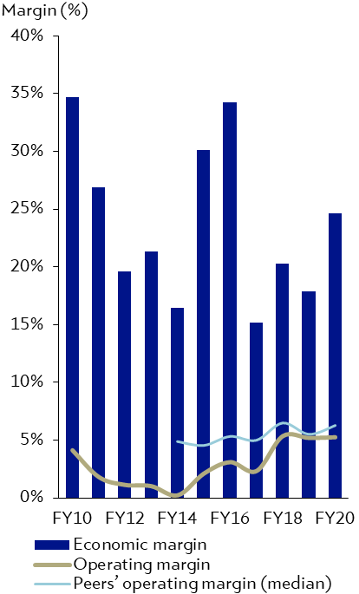
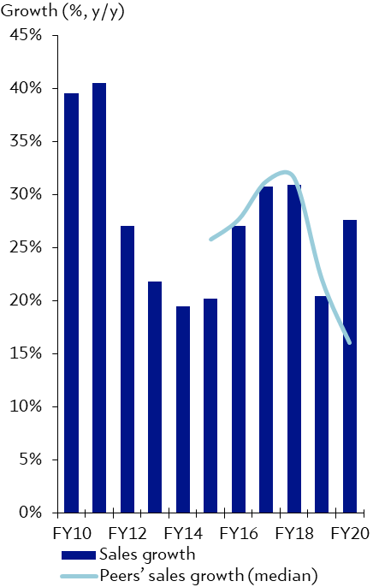
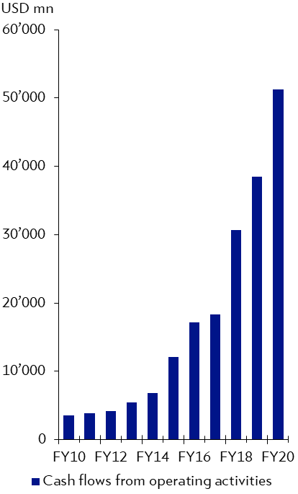
amazon
The ultimate disruptor: expanding into higher margin opportunities
AMAZON: OPERATING MARGIN VS PEERS
AMAZON: SALES GROWTH
AMAZON: CASH FLOWS
Low operating margins disguise...
…undiminished growth potential…
… and cash generating business model!
Source: Bloomberg Finance L.P., Julius Baer; Note: ‘FY20’ refers to trailing 12-month fundamental data, y/y = year-on-year
References to specific stocks do not imply any investment recommendation

Slide 26
APPLE FACING THE INNOVATOR’s DILEMMA…
Apple is not in our model portfolio. Here’s why…
APPLE: OPERATING MARGIN VS PEERS
APPLE: SALES GROWTH
APPLE: CASH FLOWS
Waning competitive advantage…
…with sales in a structural decline…
…cash flows stuck below 2015 peak!
Source: Bloomberg Finance L.P., Julius Baer; Apple Inc. (Hold, Target: USD 200); FY = fiscal year, y/y = year-on-year, mn = million;
Note: ‘FY19’ refers to last trailing 12-month metrics, not full-year results for FY2019E

Slide 27
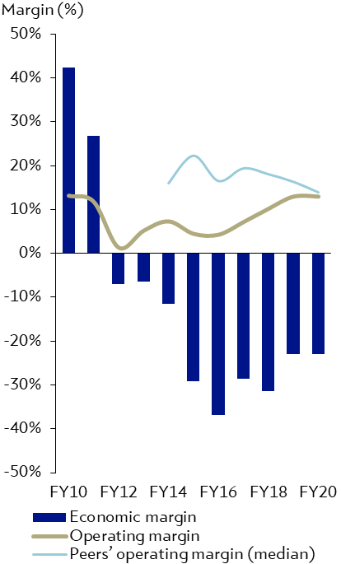
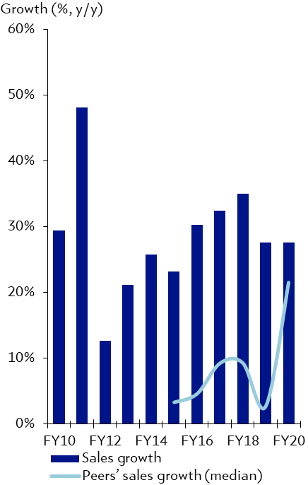
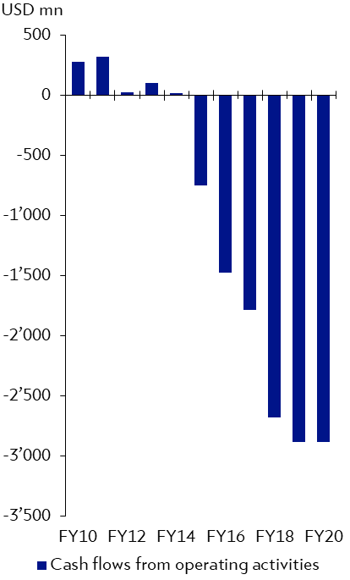
Video streaming – STIFF competition
Netflix is not in our model portfolio. Here's why…
NETFLIX : OPERATING MARGIN VS PEERS
NETFLIX: UMSATZWACHSTUM
NETFLIX: CASH FLOWS
No clear competitive advantage...
…despite robust sales growth…
… falling cash flows!
Source: Bloomberg Finance L.P., Julius Baer; Note: ‘FY20’ refers to trailing 12-month fundamental data, y/y = year-on-year
References to specific stocks do not imply any investment recommendation

Slide 28
Performance

Slide 29
Next generation MOPO performance
Model Portfolio
MODEL PORTFOLIO PERFORMANCE
31.12.2016 - 31.12.2020
Source: Bloomberg L.P., Julius Baer; At the close of 31.12.2020; calculated on total return, gross of fees basis, charges or commissions would have the effect of reducing the stated returns.

Slide 30
Next generation Fund performance
Year-to-date as at 31 December 2020
Relative performance +7.8%
31.12.2019 - 31.12.2020
THEMATIC Relative performance
31.12.2019 - 31.12.2020
Source: Bloomberg L.P., Julius Baer; At the close of 31.12.2020; calculated on total return, net of fees basis (retail K share class ISIN LU1649333934)
Source: Bloomberg L.P., Julius Baer; At the close of 31.12.2020; calculated on total return, gross of fees basis (retail K share class ISIN LU1649333934)

Slide 31
Next generation Fund positioning
Allocation & holdings — as at the close of 31 December 2020
Source: Bloomberg L.P., Julius Baer; Note: Performance calculated from 23.02.2018 to close at 31.12.2020 on a USD total return basis, net of fees and other costs as per the Next Generation UCITS Fund (K Share Class ISIN LU1649333934). *Proxy iShares MSCI ACWI UCITS ETF USD used where MSCI ACW Index data unavailable. Cash and cash equivalent data excluded from allocations and holdings. References to specific stocks do not imply any investment recommendation.

Slide 32
Next generation Fund performance
Since UCITS fund inception – thematic comparison as at 31 December 2020
THEMATIC PEER GROUP PERFORMANCE
23.02.2018 - 31.12.2020
Source: Bloomberg L.P., Julius Baer; At the close of 31.12.2020. The quoted returns are gross of any fees, charges or commissions would have the effect of reducing the stated returns; cash and cash equivalents are excluded.

Slide 33
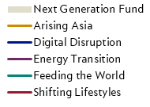
Next generation Fund performance
2020 Sub-theme performance review (in USD)
SUB-THEMES PERFORMANCE RANKING
31.12.2019 - 31.12.2020
Source: Bloomberg L.P., Julius Baer; At the close of 31.12.2020. Performance calculated from 31.12.2019 to close at 31.12.2020 on a USD total return basis, gross of fees and other costs as per the Next Generation UCITS Fund. Past performance and performance forecasts are not reliable indicators of future results. *Currently no position.

Slide 34
Next generation Fund Performance
2020 Absolute performance of holdings in % (in USD)
STOCKS ABSOLUTE PERFORMANCE (in USD)
31.12.2019 - 31.12.2020
Source: Bloomberg L.P., Julius Baer; Note: Performance calculated from 31.12.2019 to close at 31.12.2020 on a USD total return basis gross of fees and transaction costs. References to specific stocks do not imply any investment recommendation. *Not in portfolio anymore.

Slide 35
Julius Baer Equity Next Generation Fund
Additional information as at 31 December 2020
ASSET TURNOVER
2019 40.7%
2020 23.6%
ASSET UNDER MANAGEMENT
2019 USD 578 mn
2020 USD 679 mn
TOTAL EXPENSE RATIO
(K SHARE CLASS)
2019 0.97%
(as of 31.12.2019)
2020 0.98%
(as of 30.06.2020)
NUMBER OF STOCKS IN FUND
2019 61
2020 64
Source: Bloomberg L.P., Julius Baer; Data as of 31.12.2020 as per the Next Generation UCITS Fund (K Share Class ISIN LU1649333934).

Slide 36
TEAM
Notes:
Key driver of superior corporate performance
!Caveat – growth is challenging to sustain
Structural growth scarcity

Slide 37



NEXT GENERATION INVESTMENT MANAGEMENT TEAM
Focus on long-term structural growth themes, and equities
Jiazhi Chen Seiler, CFA®
Managing Director Senior Advisor, Head of Next Generation (Portfolio Management), Next Generation Portfolio Manager
Jiazhi joined Julius Baer in December 2011, starting in Asia Investment Solutions, where she played a key role in supporting the ‘Asia: Our Second Home Market’ strategic initiative. From 2013 to 2016, she was Head of the Investment Specialists Growth Markets team, where she played an active role in growth markets-focused investment solutions. Jiazhi has been the Head of the Next Generation team in Research since late 2016, thereafter becoming Head of Next Generation Portfolio Management in January 2018. Prior to joining Julius Baer, she was a fund manager at Vontobel Asset Management. She has over 25 years of investment experience, with a strong focus on Asian equities, growth markets, and the ‘Arising Asia’ theme. Jiazhi holds a Bachelor of Science in Economics from HEC Lausanne (University of Lausanne, Switzerland), and is a CFA® charterholder.
Warren Kreyzig
Executive Director, Next Generation Portfolio Co-Manager, Next Generation Strategist
Warren joined Julius Baer in 2013 as a commodities research analyst, covering agriculture and thematic research. Since late 2016, Warren has joined the Next Generation team, structuring and developing the team’s investment strategy and valuation tools, as well as covering the ‘Feeding the World’ theme, which explores the challenge of sustainable food production. Prior to joining Julius Baer, Warren worked as the Head Business Development Analyst for Xstrata’s iron ore division. He has over 10 years of expertise in valuing complex real and financial assets across a diverse array of industries. Warren holds a Master in Applied Finance from the Financial Services Institute of Australasia (now known as Kaplan Professional; Melbourne, Sydney, and Brisbane, Australia).
Fabiano Vallesi
Director, Next Generation Portfolio Co-Manager, Next Generation Investment Analyst
Fabiano joined Julius Baer in 2011 and from 2013 to 2017 has been responsible for Next Generation thematic research, focusing on a broad and deep coverage of the topics and industries represented in the ‘Digital Disruption’ (technology) and ‘Shifting Lifestyles’ (healthcare and changing demographics) themes. Fabiano has been the Head of the Next Generation team in Research from late 2017 to October 2018, thereafter strengthening the Next Generation Portfolio Management team as an Investment Analyst. Fabiano holds a Master of Science in Business and Economics from the University of Basel, Switzerland, and won the faculty prize for his Master’s Thesis in 2011.

Slide 38
Questions and answers
Notes:
Gives the cue to the operator on the Q&A by mentioning “That’s it from me. I am happy to take questions at this stage”
2 Questions
What are the likely changes to the healthcare industry resulting from COVID-19?
- Shift in patient engagement with digital solutions across other industries to greatly assist the penetration of telemedicine and virtual doctor visits.
- Governments increasingly reimbursing telemedicine services.
- Catalyst for equipping hospitals with telehealth solutions (including screening systems that enable patients to identify virus cases amongst patients)
- COVID-19 is accelerating the shift towards Health IT
Could big-tech become players in the healthcare industry?
- Partnership model or acquisition (expensive)
- Partner in implementing digitalization solutions (picks and shovels)
- Amazon & Cerner Hospital IT
- Amazon exploring internal healthcare insurance models

Slide 39
IMPORTANT LEGAL INFORMATION (1/3)
General
This publication constitutes marketing material and is not the result of independent financial research. Therefore the legal requirements regarding the independence of financial research do not apply. This material is not independent from the proprietary interests of Julius Baer (e.g. certain Julius Baer products may be mentioned in this publication), which may conflict with your interests.
The information and opinions expressed in this publication were produced by Bank Julius Baer & Co. Ltd., Zurich, as of the date of writing and are subject to change without notice. This publication is intended for information purposes only and does not constitute an offer or an invitation by, or on behalf of, Julius Baer to buy or sell any securities or related financial instruments or to participate in any particular trading strategy in any jurisdiction. Opinions and comments of the authors reflect their current views, but not necessarily of other Julius Baer entities or any other third party. Other Julius Baer entities may have issued, and may in the future issue, other publications that are inconsistent with, and reach different conclusions from, the information presented in this publication. Julius Baer assumes no obligation to ensure that such other publications are brought to the attention of any recipient of this publication.
Suitability
Investments in the asset classes mentioned in this publication may not be suitable for all recipients and may not be available in all countries. Clients of Julius Baer are kindly requested to get in touch with the local Julius Baer entity in order to be informed about the services and/or products available in such country. This publication has been prepared without taking account of the objectives, financial situation or needs of any particular investor. Before entering into any transaction, investors should consider the suitability of the transaction to individual circumstances and objectives. Any investment or trading or other decision should only be made by the client after a thorough reading of the relevant product term sheet, subscription agreement, information memorandum, prospectus or other offering document relating to the issue of the securities or other financial instruments. Where reference to a specific research report is made this publication should not be read in isolation without reference to this full research report which may be provided upon request. Nothing in this publication constitutes investment, legal, accounting or tax advice, or a representation that any investment or strategy is suitable or appropriate to individual circumstances, or otherwise constitutes a personal recommendation to any specific investor. Any references to a particular tax treatment depend on the individual circumstances of each investor and may be subject to change in the future. Julius Baer recommends that investors independently assess, with a professional advisor, the specific financial risks as well as legal, regulatory, credit, tax and accounting consequences.
Information / forecasts referred to
Although the information and data herein are obtained from sources believed to be reliable, no representation is made that the information is accurate or complete. In particular, the information provided in this publication may not cover all material information on the financial instruments or issuers of such instruments. Bank Julius Baer & Co. Ltd., Zurich, its subsidiaries and affiliated companies do not accept liability for any loss arising from the use of this publication.
Important sources for the production of this publication are e.g. national and international media, information services (e.g. Reuters, Bloomberg Finance L.P.), publicly available databases, economic journals and newspapers (e.g. Financial Times, Wall Street Journal), publicly available company information, publications of rating agencies. Ratings and appraisals contained in this publication are clearly marked as such.
All information and data used for this publication relate to past or present circumstances and may change at any time without prior notice. Statements contained in this publication regarding financial instruments or issuers of financial instruments relate to the time of the production of this publication. Such statements are based on a multitude of factors which are subject to continuous change. A statement contained in this publication may, thus, become inaccurate without this being published. Potential risk regarding statements and expectations expressed in this publication may result from issuer specific and general (e.g. political, economic, market, etc.) developments.
Risk
The price and value of, and income from investments in any asset class mentioned in this publication may fall as well as rise and investors may not get back the amount invested. Risks involved in any asset class mentioned in this publication may include but are not necessarily limited to market risks, credit risks, political risks and economic risks. The investor may be exposed to currency risk, because the product or underlyings of the product are denominated in other currencies than that of the country in which the investor is resident. The investment as well as its performance are therefore exposed to currency fluctuations and may increase or decrease in value.
Particular risks in connection with specific investments featured in this publication are disclosed in the relevant product term sheet, subscription agreement, information memorandum, prospectus or other offering document relating to the issue of the securities or other financial instruments. These documents can be obtained free of charge upon request.

Slide 40
IMPORTANT LEGAL INFORMATION (2/3)
Investments in emerging markets are speculative and may be considerably more volatile than investments in established markets. Clients should not be investing in the product unless they fully understand the feature and risks associated with it. Past performance is not a reliable indicator of future results. Performance forecasts are not a reliable indicator of future performance. Shares, bank debt securities (e.g. interest bearing bank bonds and certificates) as well as other claims against financial institutions are subject to special regulations such as the “Bank Recovery and Resolution Directive” and the “Single Resolution Mechanism Regulation”. These regulations can have a negative effect for the investor / contractual partner of the financial institution in case of a default and the necessity of a resolution of the financial institution. For further details, please refer to: www.juliusbaer.com/legal-information-en.
Structured products (e.g. baskets, certificates) are complex financial products and therefore involve a higher degree of risk. They are intended for investors who understand and are capable of assuming all risks involved. Structured products may therefore only be sold to experienced investors and require additional advice regarding the products specific risks. The value of the products is not only dependent on the development of the underlying, but also on the creditworthiness of the issuer, which may vary over the term of the product. In case of the issuer’s insolvency or bankruptcy, the investor in the product may lose his entire investment. Before entering an investment all documents related to the issue of the described structured product have to be read. The full terms of the respective structured product may be obtained free of charge.
Investments in funds mentioned in this publication should only be made after a thorough reading of the current prospectus, the current Key Investor Information Document or simplified prospectus, the fund regulations or articles of association and the latest annual and semi-annual reports. These documents can be obtained free of charge upon request. The value of the units and the return they generate can go down as well as up. Performance values are calculated without taking account of commissions and costs that result from selling and buying back investments.
Conflict of Interests
We are required to disclose important information about our interests and potential conflicts. In order to prevent conflicts of interest from adversely affecting the interests of its clients, Julius Baer has established a policy and procedures which are designed to identify and manage such conflicts. These include organizational and administrative arrangements to safeguard the interests of clients. Julius Baer's arrangements include adequate remuneration policies (for persons involved in the production of this publication) based largely on qualitative criteria (e.g. overall quality and accuracy of research) and only remotely on
quantitative elements (e.g. overall performance of Julius Baer).
A Julius Baer entity may, to the extent permitted by law, participate or invest in other financing transactions with the issuer of the securities referred to herein, perform services or solicit business from such issuers, have a position or effect transactions in the securities or options thereof, have any other significant financial interest regarding the issuers of the securities referred to herein and/or may have done so in the past. For further information about our interest in the investments featured in this publication, see the company-specific disclosures above.
Important Distribution Information
This publication and any market data contained therein shall only be for the personal use of the intended recipient and shall not be redistributed to any third party, unless Julius Baer or the source of the relevant market data gives their approval.This publication is not directed to any person in any jurisdiction where (by reason of that person’s nationality, residence or otherwise) such publications are prohibited.
External Asset Managers/External Financial Advisers: in case this marketing publication is provided to an External Asset Manager or an External Financial Adviser, Julius Baer expressly prohibits that it is redistributed by the External Asset Manager or the External Financial Adviser and is made available to their clients and/or third parties. By receiving any marketing publication the External Asset Managers or the External Financial Advisers confirm that they will make their own independent analysis and investment decisions, if applicable.
Switzerland: in Switzerland this publication has been distributed by Bank Julius Baer & Co. Ltd., Zurich, authorised and regulated by the Swiss Financial Market Supervisory Authority FINMA. All investment funds mentioned in this publication are authorised for distribution in Switzerland.

Slide 41
IMPORTANT LEGAL INFORMATION (3/3)
United States: NEITHER THIS PUBLICATION NOR ANY COPY THEREOF MAY BE SENT, TAKEN INTO OR DISTRIBUTED IN THE UNITED STATES OR TO ANY US PERSON.
This publication may contain information obtained from third parties, including ratings from rating agencies such as Standard & Poor’s, Moody’s, Fitch and other similar rating agencies, and research from research providers such as MSCI ESG Research LLC or its affiliates. Issuers mentioned or included in any MSCI ESG Research LLC materials may be a client of or affiliated with a client of MSCI Inc. (“MSCI”) or another MSCI subsidiary. Reproduction and distribution of third-party content in any form is prohibited except with the prior written permission of the related third party. Third-party content providers do not guarantee the accuracy, completeness, timeliness or availability of any information, including ratings or research, and are not responsible for any errors or omissions (negligent or otherwise), regardless of the cause, or for the results obtained from the use of such content.
Third-party content providers give no express or implied warranties, including, but not limited to, any warranties of merchantability or fitness for a particular purpose or use. Third-party content providers shall not be liable for any direct, indirect, incidental, exemplary, compensatory, punitive, special or consequential damages, costs, expenses, legal fees or losses (including lost income or profits and opportunity costs) in connection with any use of their content, including ratings or research. Credit and/or research ratings are statements of opinions and are not statements of fact or recommendations to purchase, hold or sell securities. They do not address the market value of securities or the suitability of securities for investment purposes and should not be relied on as investment advice.
South Africa: This publication is distributed by Julius Baer South Africa (Pty) Ltd, which is an authorised financial services provider (FSP no. 49273) approved by the Financial Sector Conduct Authority. Julius Baer is also licensed in South Africa as a representative office of a foreign bank.
© Julius Baer Group, 2021

Slide 42
JULIUS BAER GROUP
Head Office
  Bahnhofstrasse 36, P.O. Box,
  8010 Zurich, Switzerland
  www.juliusbaer.com

